Slide 1
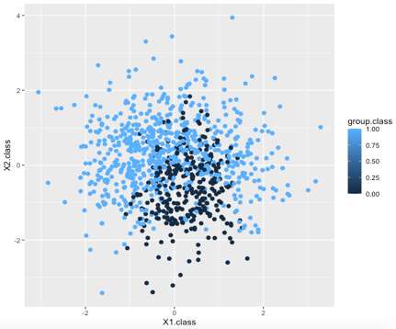

Classification methods to approximate a Bayes classifier
Nicholas P.J. Harper, 700038738
Problem:
Find the best method to classify a dataset of X1 and X2 data

Slide 2
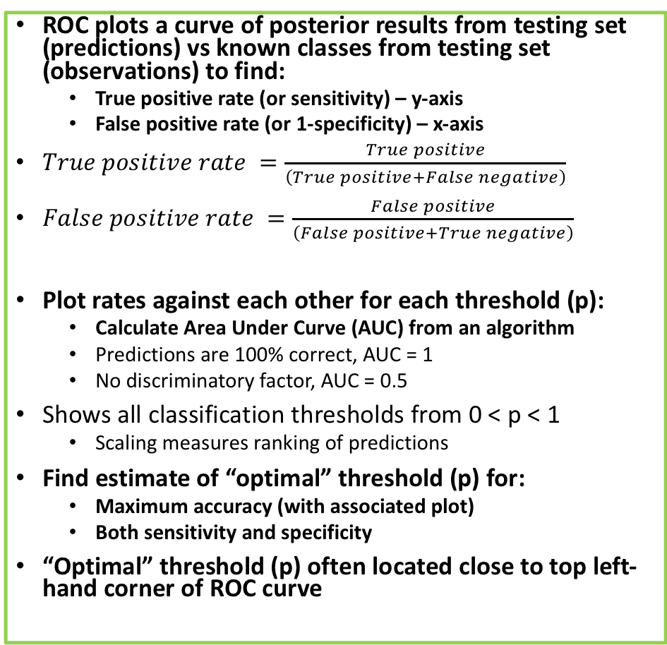
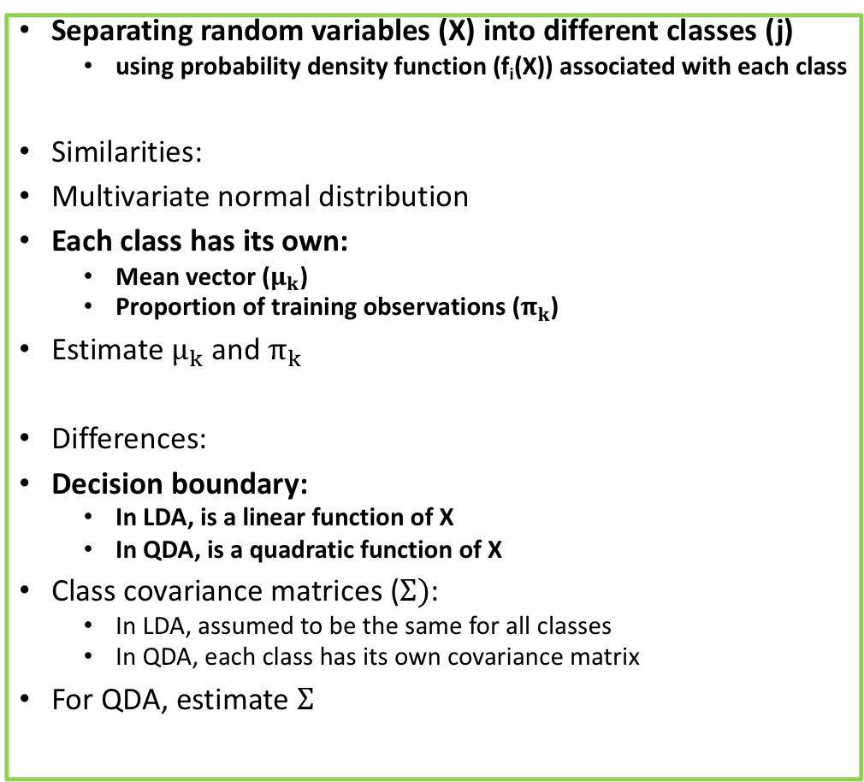
Linear and Quadratic Discriminant Analyses (LDA & QDA) and optimisation using Receiver-Operator curves (ROC)
Separating random variables (X) into different classes (j)
using probability density function (f_{i}(X)) associated with each class
Similarities:
Multivariate normal distribution
Each class has its own:
Mean vector ($μ_{k}$)
Proportion of training observations ($π_{k}$)
Estimate $μ_{k}$ and $π_{k}$
Differences:
Decision boundary:
In LDA, is a linear function of X
In QDA, is a quadratic function of X
Class covariance matrices ($Σ)$:
In LDA, assumed to be the same for all classes
In QDA, each class has its own covariance matrix
For QDA, estimate $Σ$
ROC plots a curve of posterior results from testing set (predictions) vs known classes from testing set (observations) to find:
True positive rate (or sensitivity) – y-axis
False positive rate (or 1-specificity) – x-axis
$True positive rate =\frac{True positive}{\left(True positive+False negative\right)}$
$False positive rate =\frac{False positive}{\left(False positive+True negative\right)}$
Plot rates against each other for each threshold (p):
Calculate Area Under Curve (AUC) from an algorithm
Predictions are 100% correct, AUC = 1
No discriminatory factor, AUC = 0.5
Shows all classification thresholds from 0 < p < 1
Scaling measures ranking of predictions
Find estimate of “optimal” threshold (p) for:
Maximum accuracy (with associated plot)
Both sensitivity and specificity
“Optimal” threshold (p) often located close to top left-hand corner of ROC curve

Slide 3
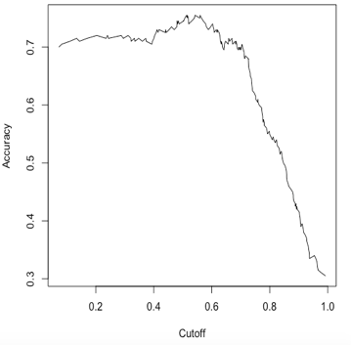
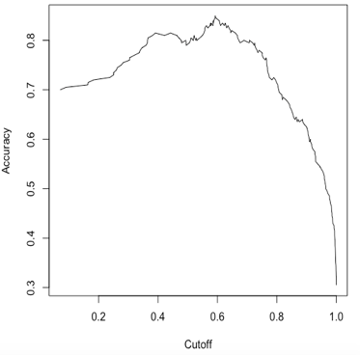
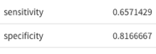
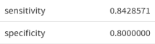
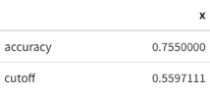
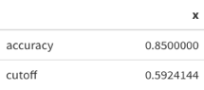
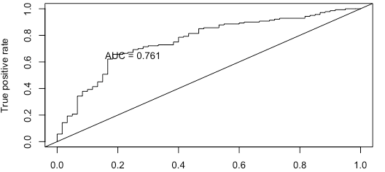
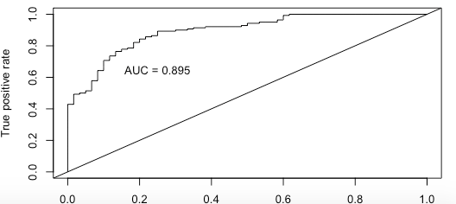
LDA results
QDA results

Slide 4
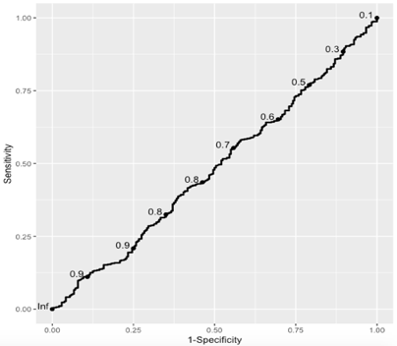
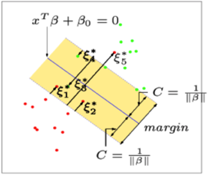
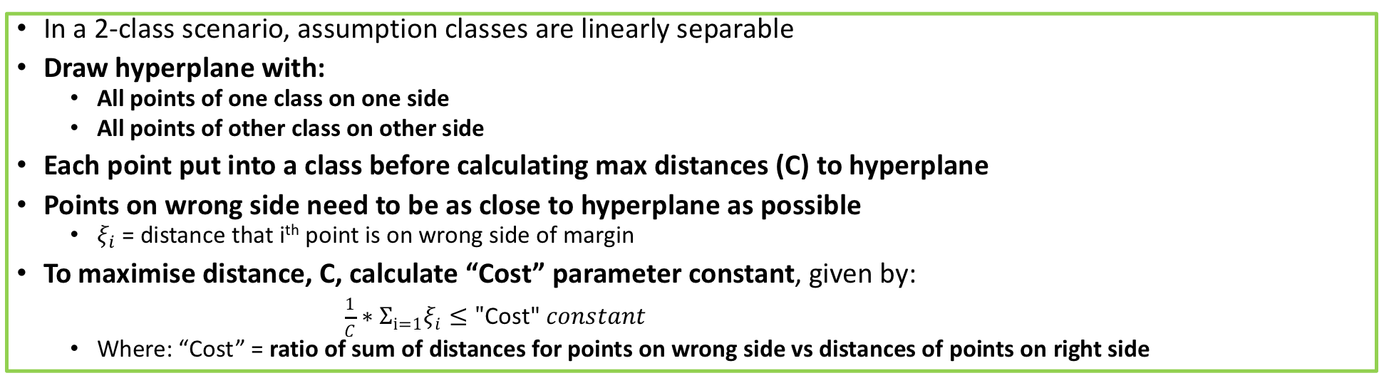
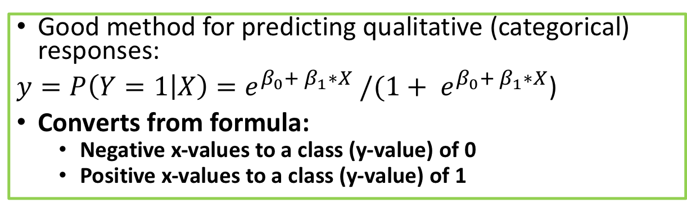
Logistic Regression and support vector machines (SVM)
Good method for predicting qualitative (categorical) responses:
$y=P\left(Y=1 | X\right)=e^{β_{0}+ β_{1}∗X} /(1+ e^{β_{0}+ β_{1}∗X}$)
Converts from formula:
Negative x-values to a class (y-value) of 0
Positive x-values to a class (y-value) of 1
AUC ~ 0.5
No discriminatory factor
In a 2-class scenario, assumption classes are linearly separable
Draw hyperplane with:
All points of one class on one side
All points of other class on other side
Each point put into a class before calculating max distances (C) to hyperplane
Points on wrong side need to be as close to hyperplane as possible
$ξ_{i}$ = distance that i^{th} point is on wrong side of margin
To maximise distance, C, calculate “Cost” parameter constant, given by:
$\frac{1}{C}∗Σ_{i=1}ξ_{i}≤"\text{Cost}\text{" }constant$
Where: “Cost” = ratio of sum of distances for points on wrong side vs distances of points on right side

Slide 5
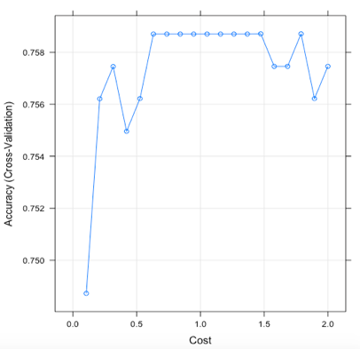
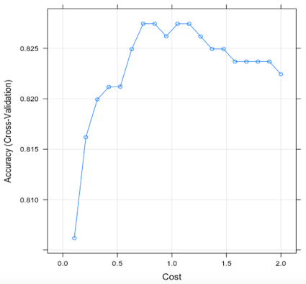
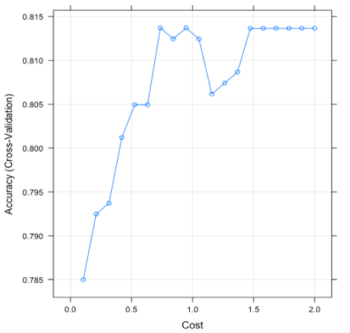
SVM optimisation via Kernel transformation
“Cost” function is optimised by transformations using different SVM Kernel functions:
Linear (Kernels create linear hyperplanes)
Radial (Kernels create circular hyperplanes)
Polynomial (Kernels create polynomial hyperplanes)
“Optimal cost” shown in plots of accuracy vs. “Cost” for each SVM technique
Linear SVM
Radial SVM
Polynomial SVM
Accuracy ~ 0.760
Cost ~ 1
Accuracy ~ 0.825 Cost > 1
Accuracy ~ 0.815 Cost > 1

Slide 6
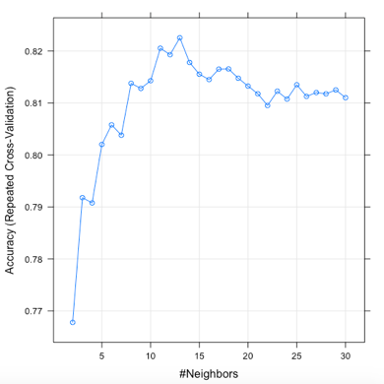
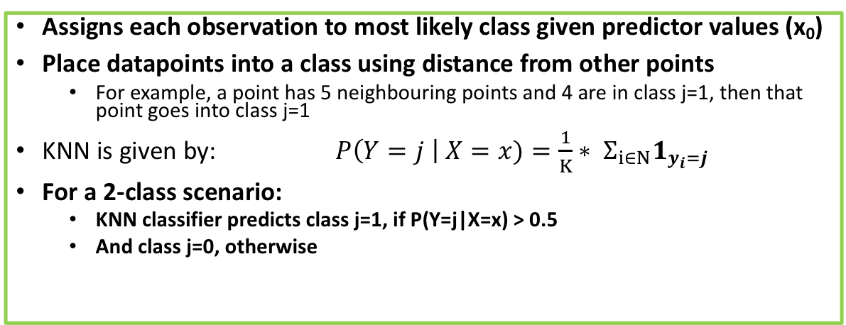
K-Nearest Neighbors (KNN) and k-folds cross-validation
Assigns each observation to most likely class given predictor values (x₀)
Place datapoints into a class using distance from other points
For example, a point has 5 neighbouring points and 4 are in class j=1, then that point goes into class j=1
KNN is given by: $P\left(Y=j \right| X=x)=\frac{1}{K}∗ Σ_{i∈N}1_{y_{i}=j}$
For a 2-class scenario:
KNN classifier predicts class j=1, if P(Y=j|X=x) > 0.5
And class j=0, otherwise
Fitting KNN model requires dealing with trade-off between over-fitting model and having too simple a model
Cross-validation method used is k-folds cross-validation:
Cut training dataset into equally sized k-portions (start at k=3)
Remove 1 portion to be used later
Test model on remaining (k-1) portions
Validate this model on removed portion
Repeat by removing each portion in turn until all portions are tested
Process repeats for different k-values (i.e. 4, 5, etc.) up to a limit to find “optimal” k-value with highest accuracy
K-value has “optimal” trade-off between bias (for lower k-values) and variance (for higher k-values)
“Optimal” k-value shown in a plot of accuracy vs. no. of neighbours
Accuracy ~ 0.820
Optimal k-value = 13

Slide 7
Conclusions
Dataset trained and tested using:
Linear Discrimination analysis (with ROC optimization)
Quadratic Discrimination analysis (with ROC optimization)
Logistic regression (with ROC optimization)
Support vector analysis (with Linear, Radial and Polynomial Kernel transformation)
K-nearest neighbours (with k-folds cross-validation)
More details of each method and optimization technique found in report
“Optimal” method is QDA
Highest accuracy (85%)
Highest relative combinations of sensitivity (~84%) and specificity (80%)

